Slide 1


Slide 2

Jupyter Notebook to GitHub

Slide 3
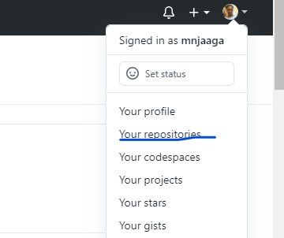

Prerequisites
Create a repository in Github.com by:
- Logging into your account
- Navigate to the profile icon on the top right and click repositories
- Create a new repository

Slide 4
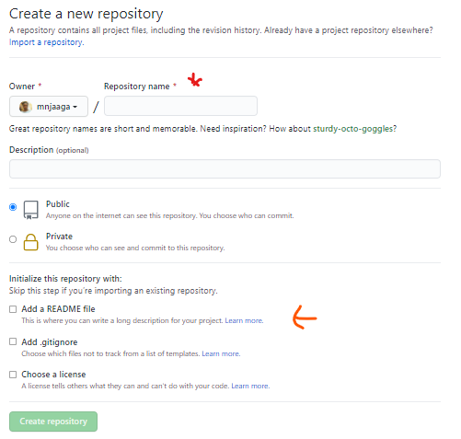

Slide 5
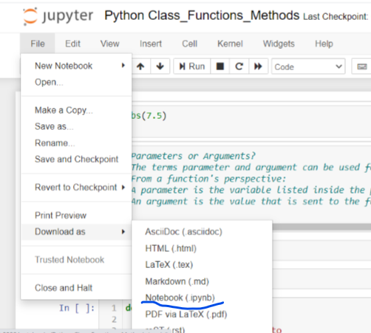
Navigate to Jupyter Notebook
select the file you want to move to Github
download as below
This saves your file in your downloads folder on your local machine

Slide 6
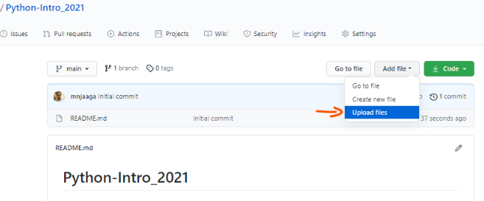
Navigate back to github.com and upload your downloaded file into your repository

Slide 7
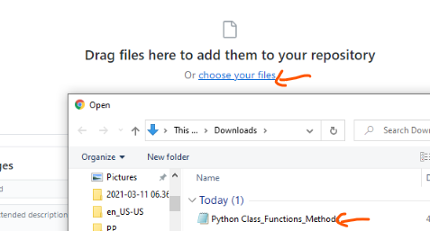

There are 2 options:
Drag file
Choose your file
(confirm your file name before uploading)
All changes Must be commited

Slide 8
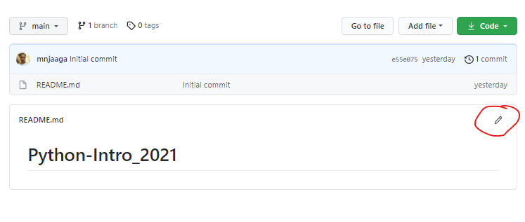
Edit ReadMe with explanation on the file you have uploaded. This can include use case, screenshots etc
Note: All changes must be COMMITED

Slide 9

Google Colab to Github

Slide 10
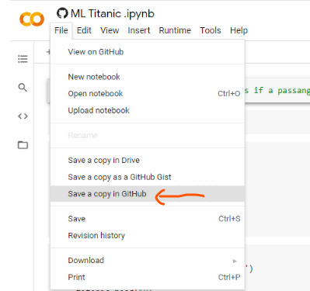
Create your repository in Github.com (see slides 3&4)
Navigate to your file in colab

Slide 11
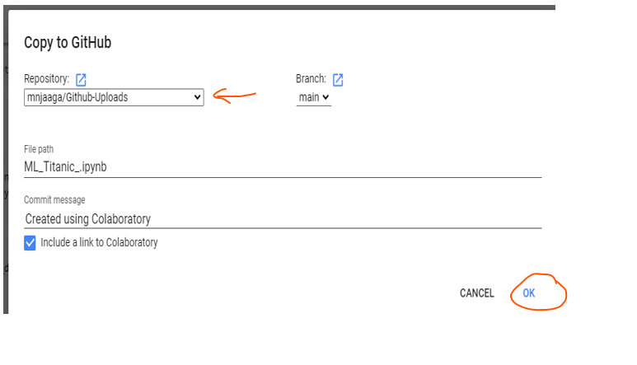

Slide 12
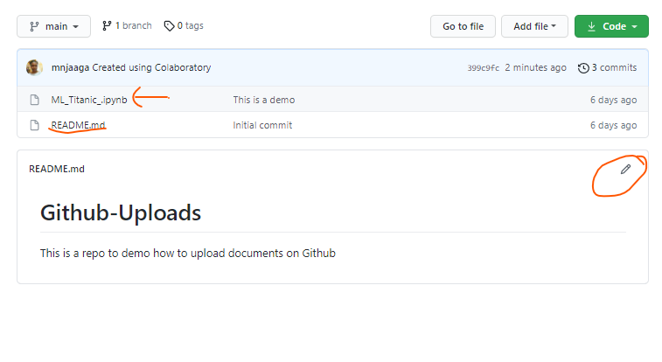
Navigate to Github.com to confirm the file upload and edit README.md

Slide 13

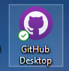
Google Colab to Github
Visual Studio Code to Github
using GitHub Desktop

Slide 14
Prerequisites:
Download Github desktop & Github.com

Slide 15
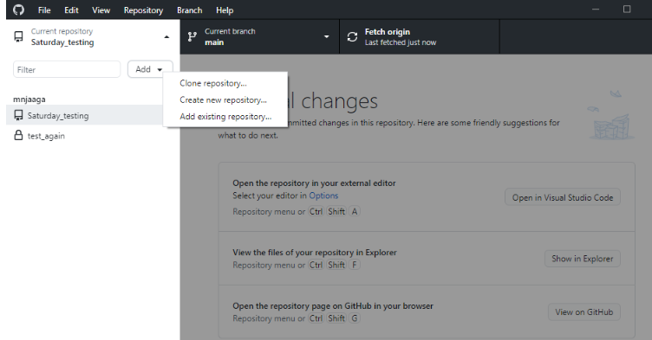
Note: You have to be signed into both Github desktop & Github.com

Slide 16
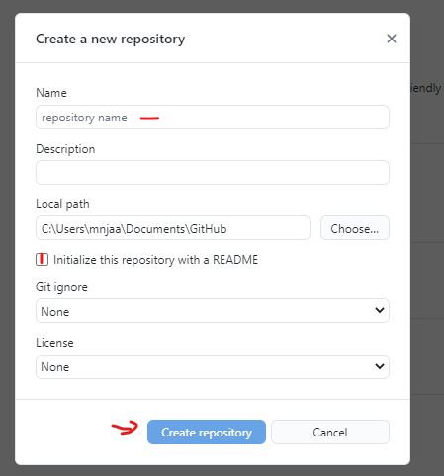

Slide 17
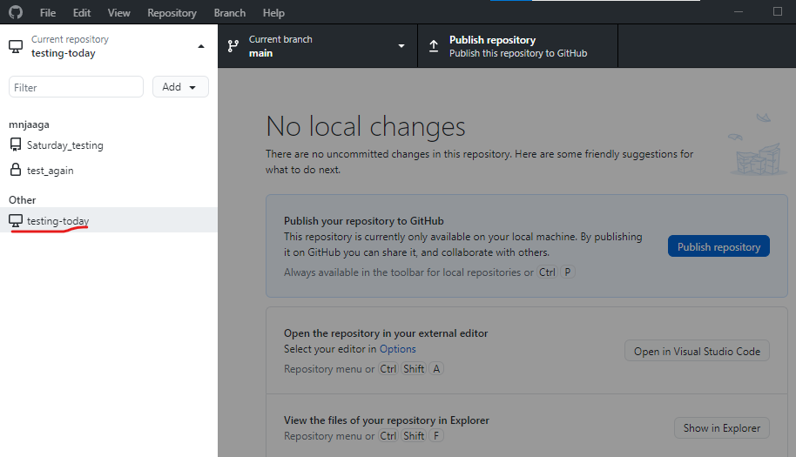
At this point, your repository is not created in Github.com until you Publish repository.
You can confirm by checking in github.com

Slide 18
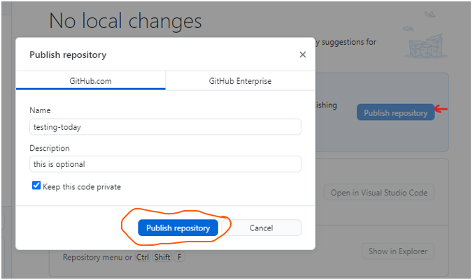

Slide 19
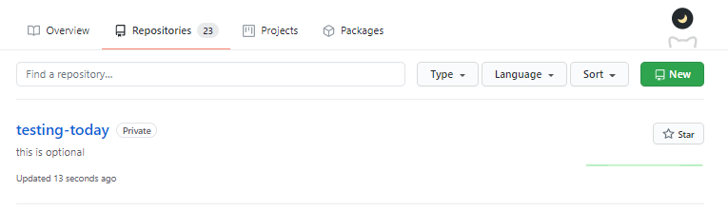
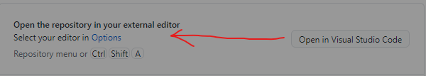
Check in github.com to confirm the existence of the new repository
A new python file has to be created to start writing your code

Slide 20
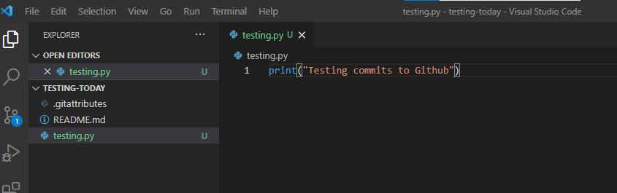
In VSCode

Slide 21
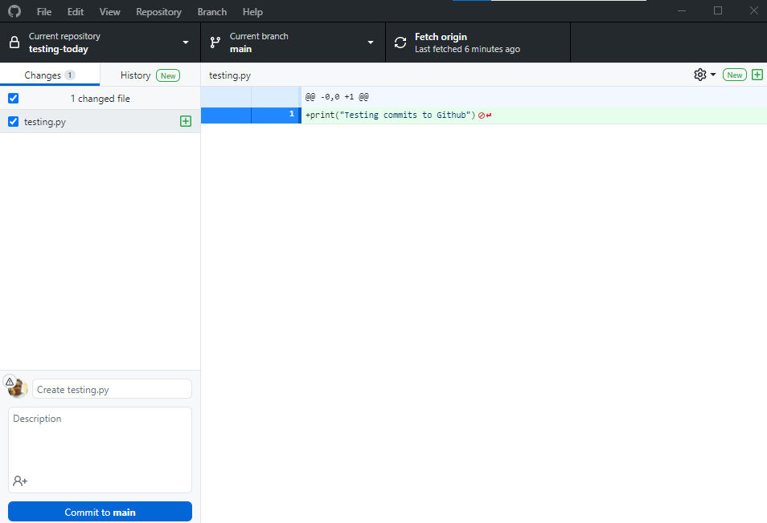
In Github desktop

Slide 22
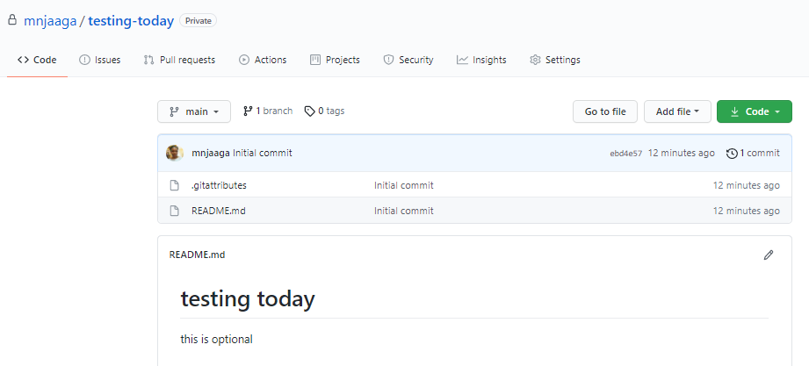
To send the changes in the repo to Github
Before:

Slide 23
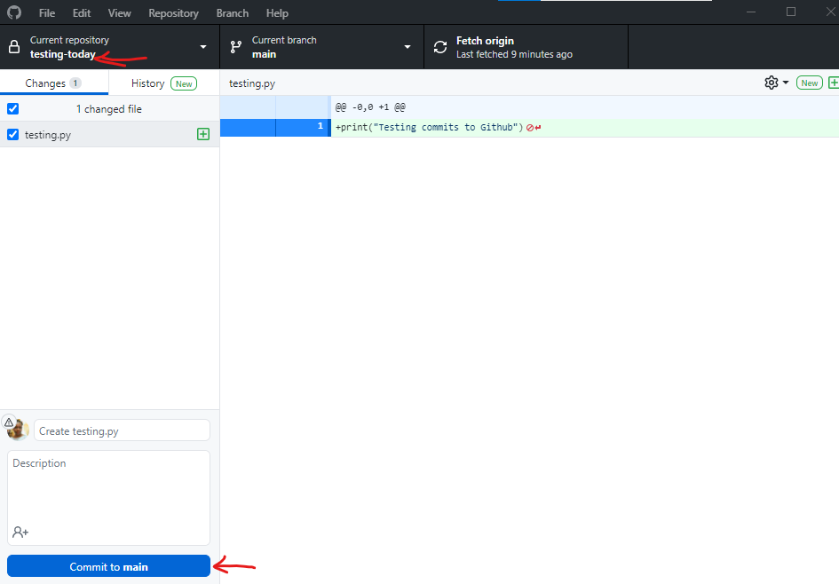
To send

Slide 24
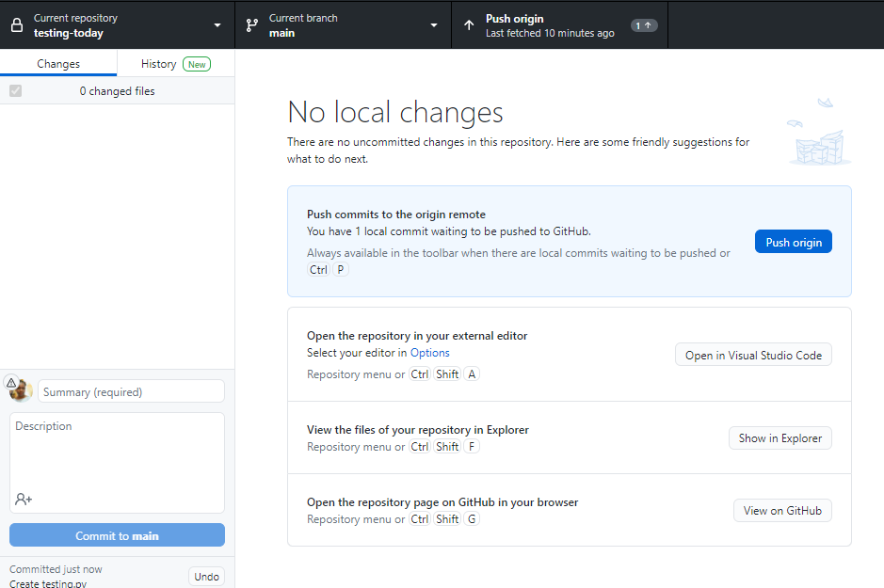
After clicking on Commit to Main, the pop up below will appear prompting a push to Github.com
At this time, your file is still not pushed into github.com, you can refresh the page to confirm

Slide 25
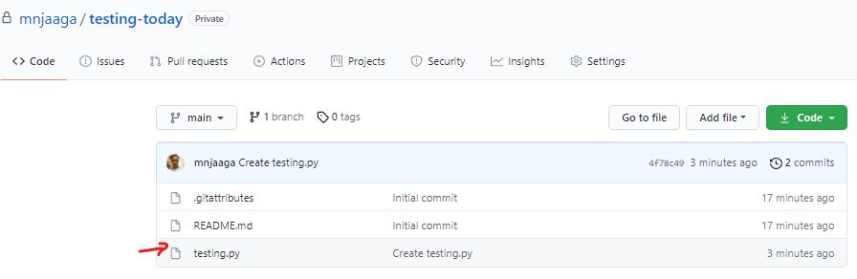

Slide 26


PYcharm to Github

Slide 27
Pre-requisites:
Sign into Github.com and create a repository (see slides 3&4). Repo does not need to have the same name as file created in Pycharm.
Create a project in PyCharm
Inside of the created project, create a new file(File can have any extension allowed by Pycharm).
Sign into Github thru Pycharm Version Control Settings Options.

Slide 28
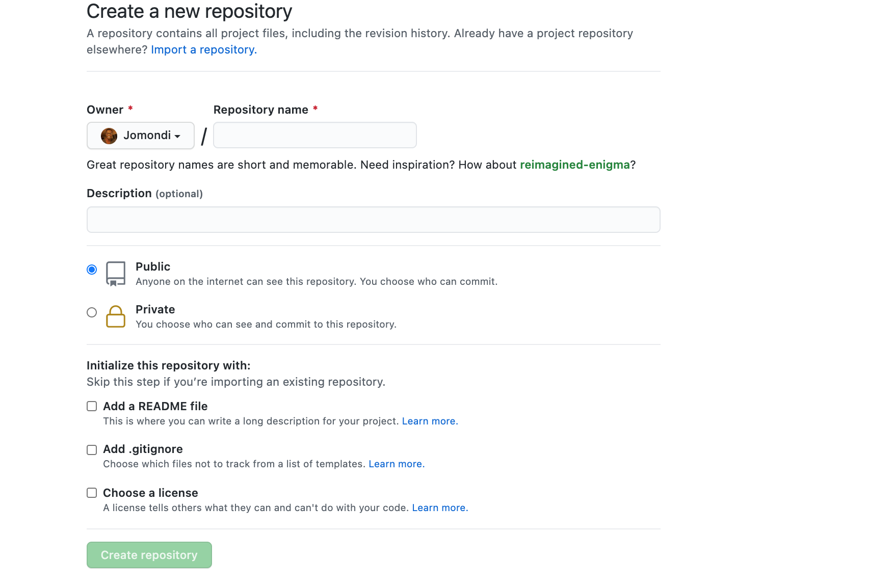

Slide 29
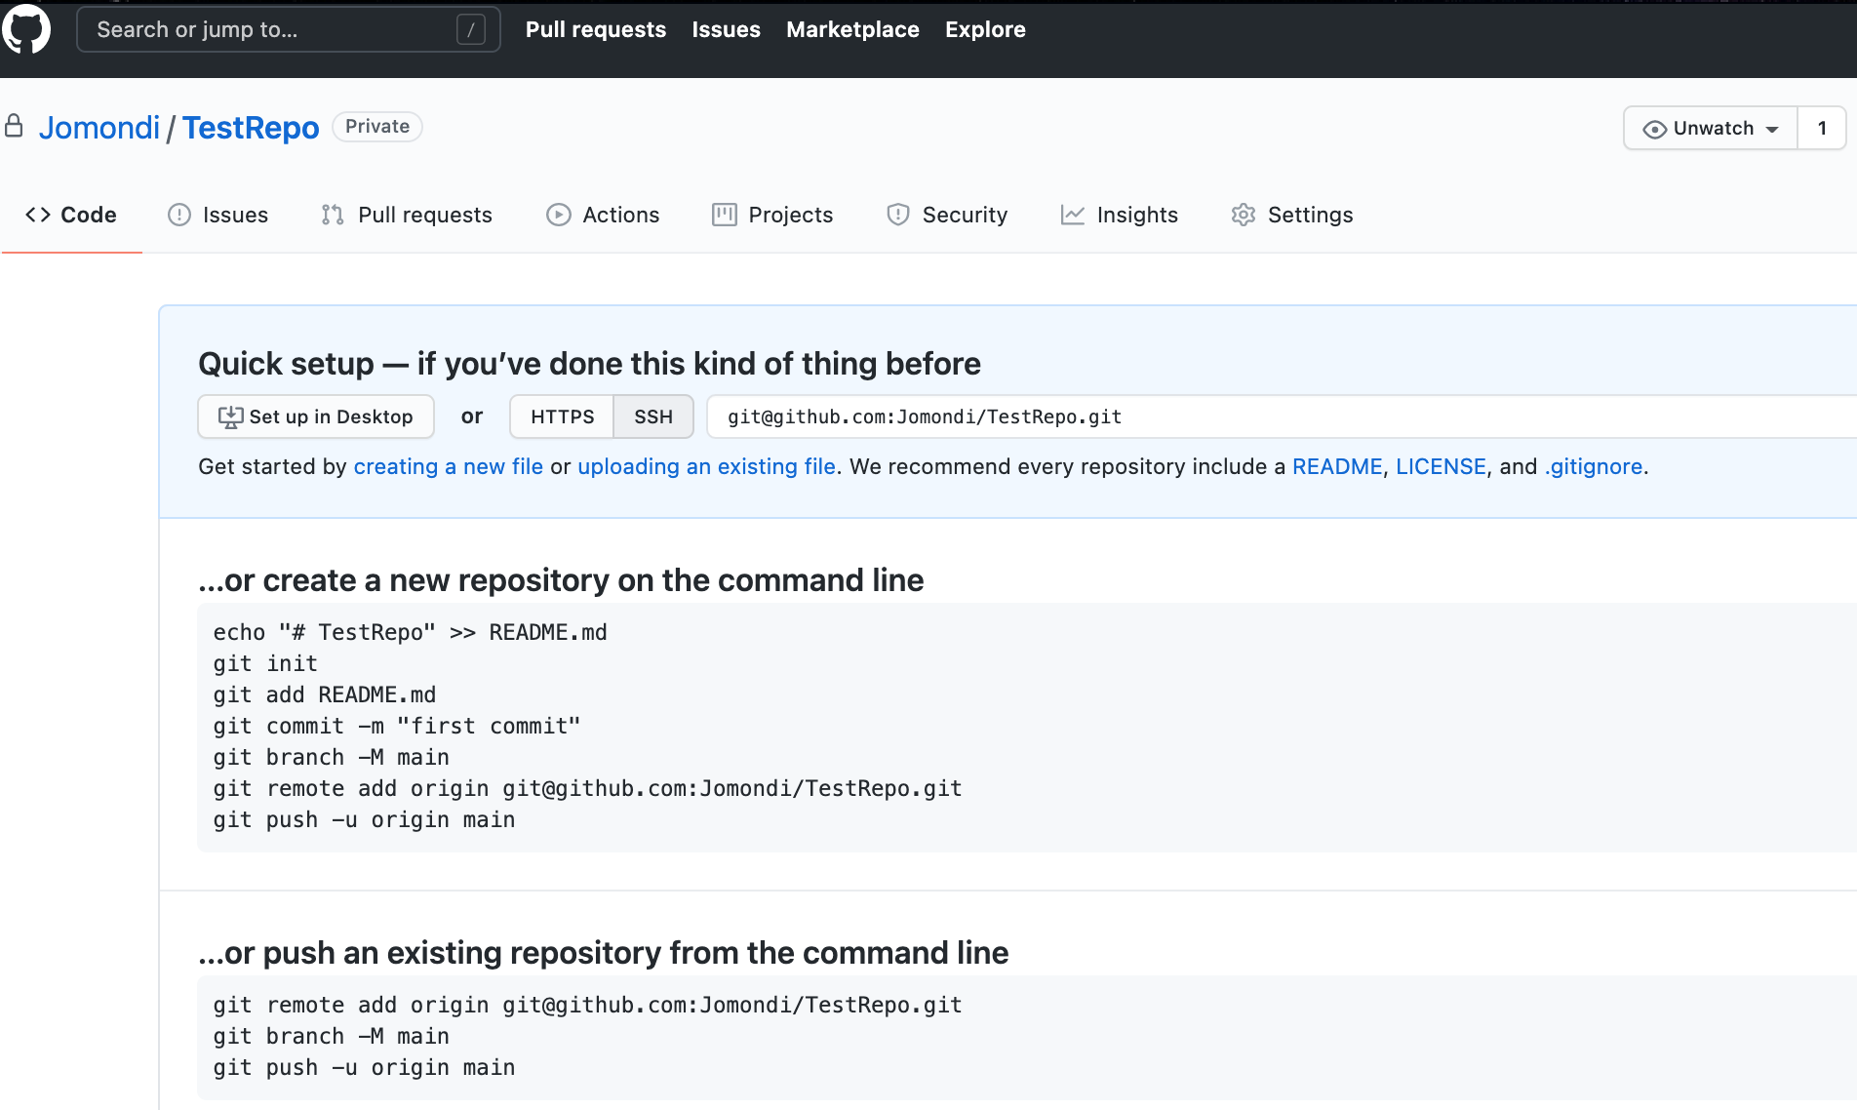
In Github.com, navigate to the repo you have created, to find the steps below to follow to commit your code from PyCharm.

Slide 30
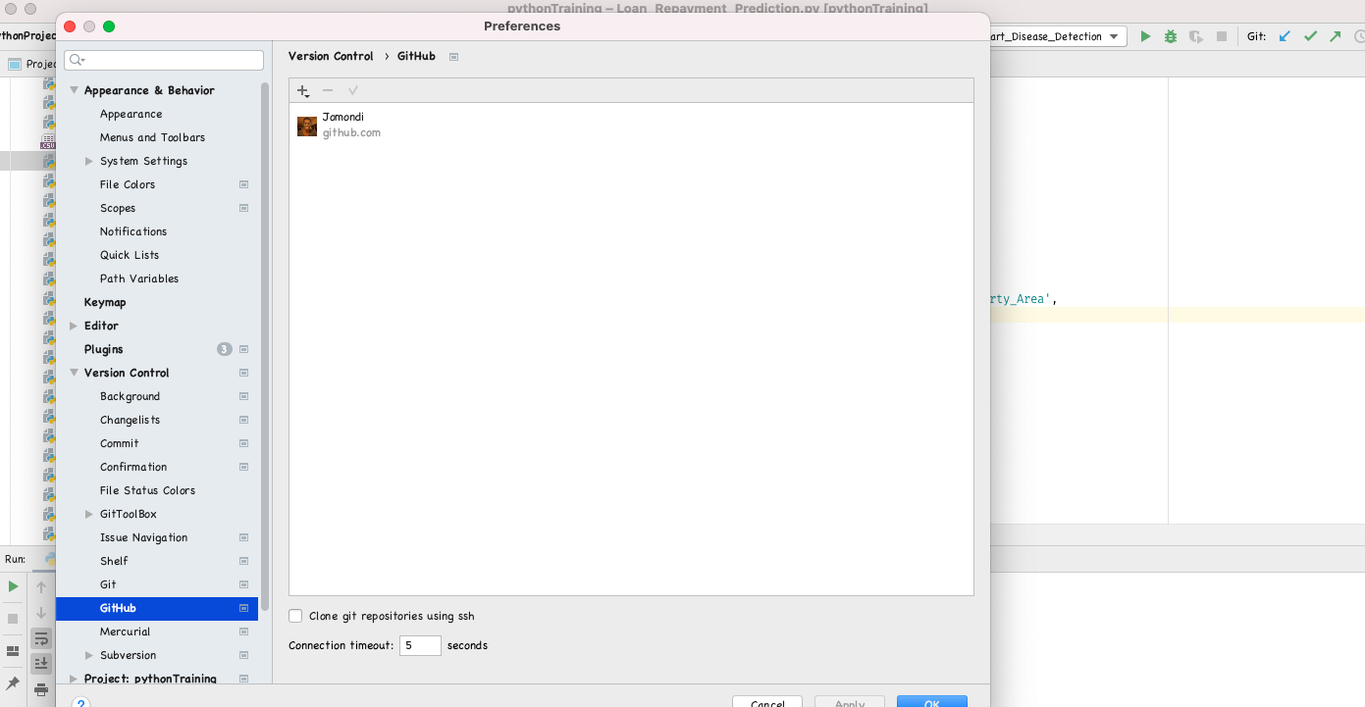
In PyCharm, create a new project – File -> New Project
If you are logged into Github.com, you will see the icons to the right (in an orange box)

Slide 31
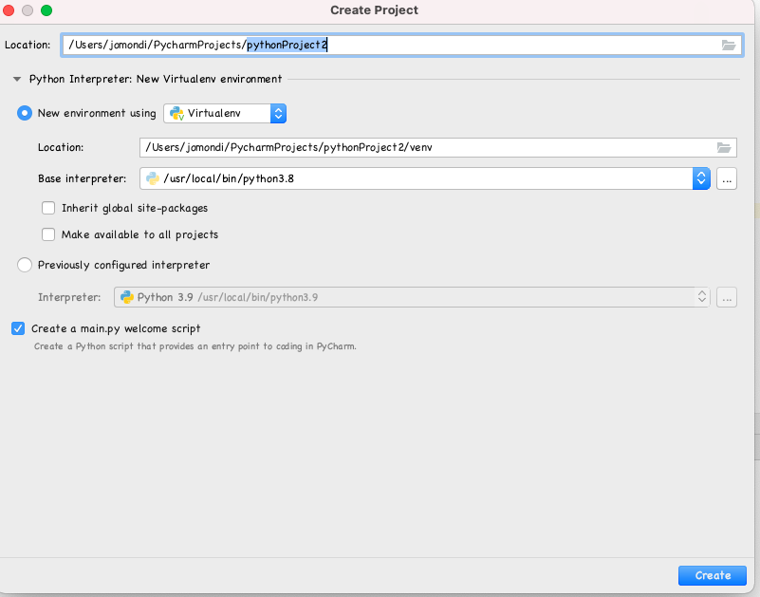
Pick a name of your choice, then click create, it is preferable that you open your project in a New window
Note: It may take a while to create the project

Slide 32
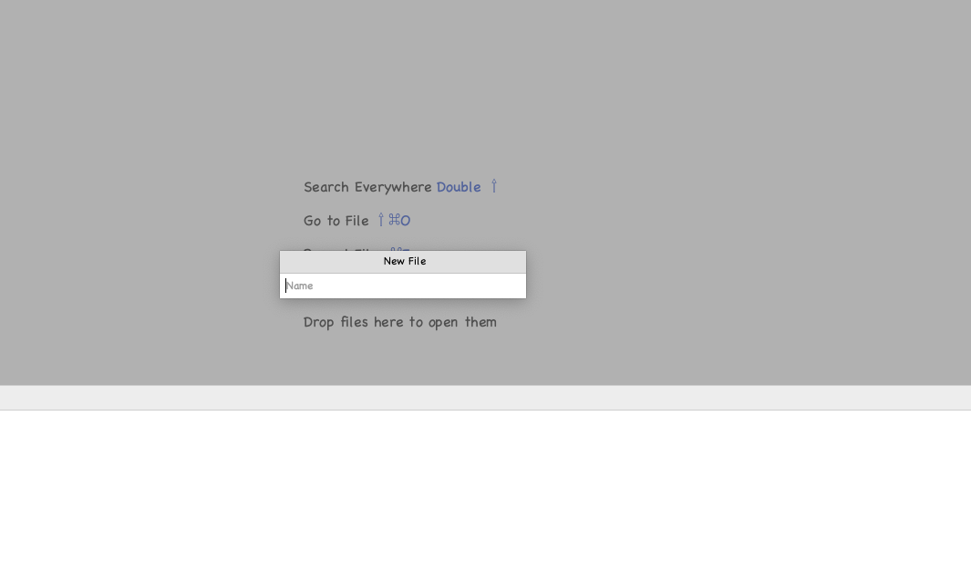
Create a new Python(.py) file

Slide 33
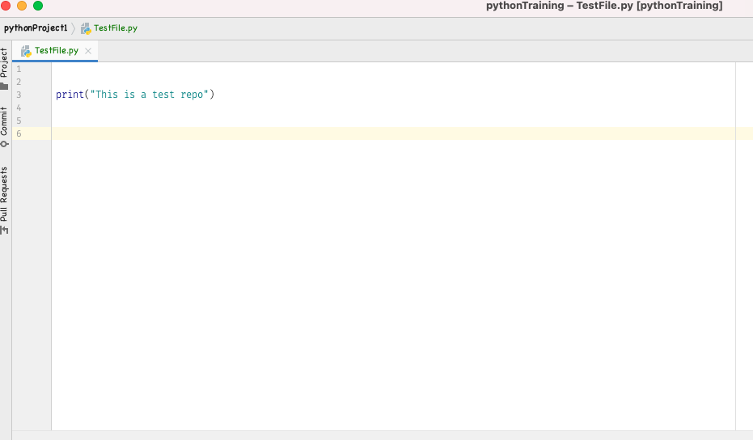

Slide 34
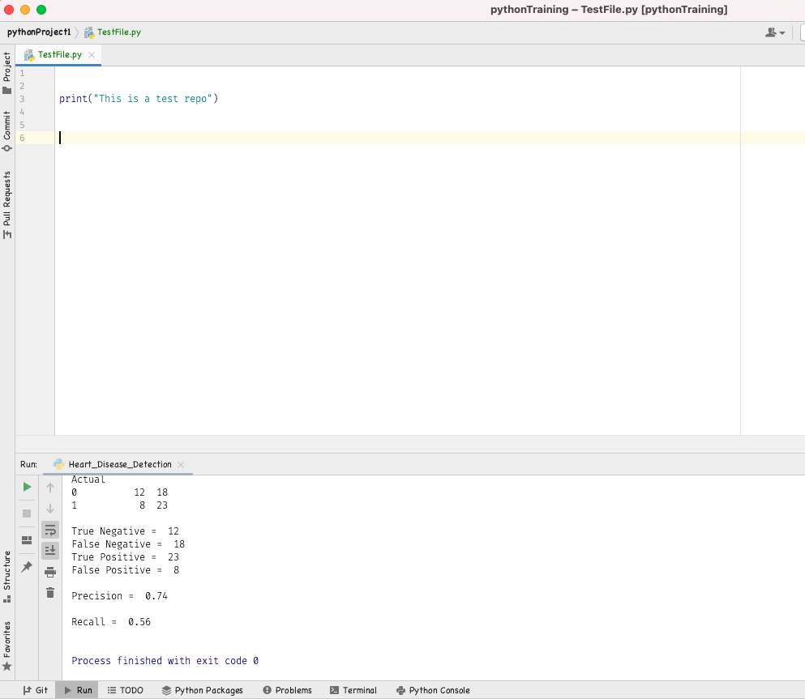
Navigate to the terminal within the Pycharm window (see circled in red)

Slide 35
In the terminal, execute the steps below in the displayed order. Ignore the git add README.md command especially if you don’t have such a file created in your local.

Slide 36
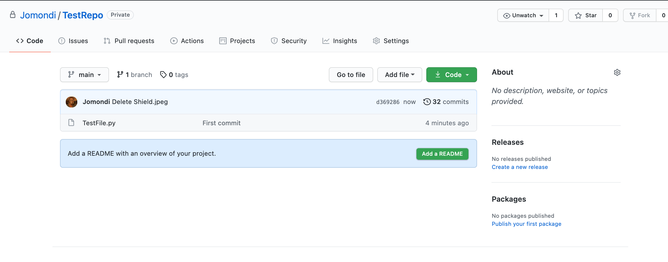
Once all commands are ran, navigate back to github and refresh the page. Newly commited file should now be visible.
You can now add a README.md file and update it with the project overview.

Slide 37
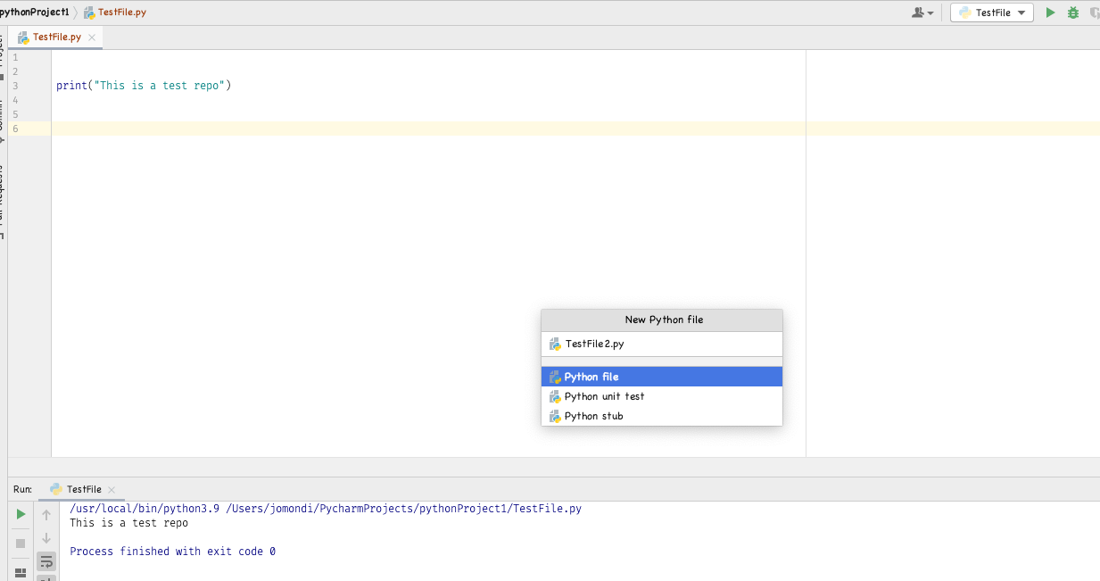
Create a new Python file and save it.

Slide 38
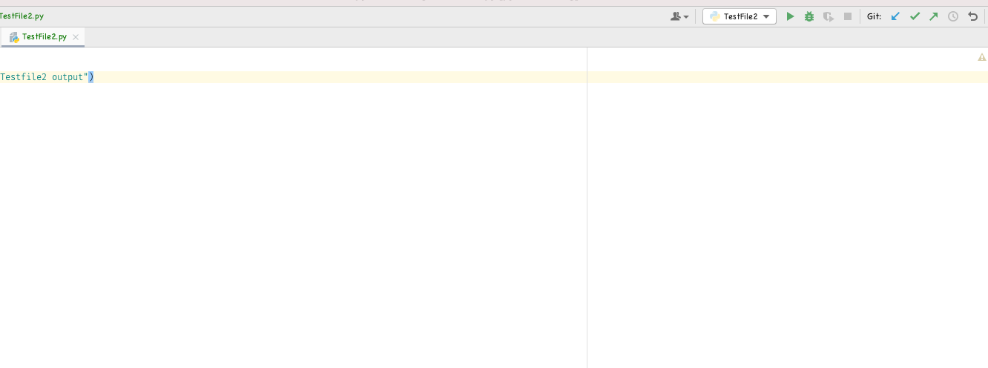
Click on update project arrow in Pycharm as displayed below.

Slide 39
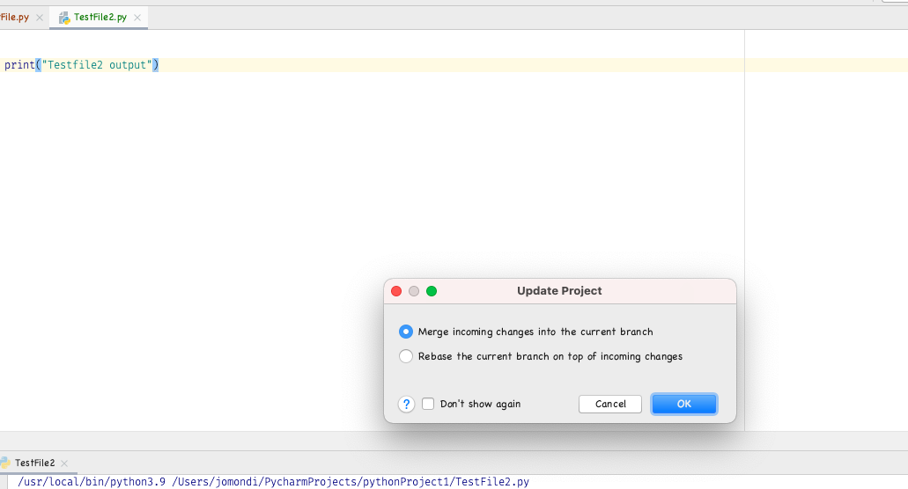
Click on OK button in the displayed pop up box.

Slide 40
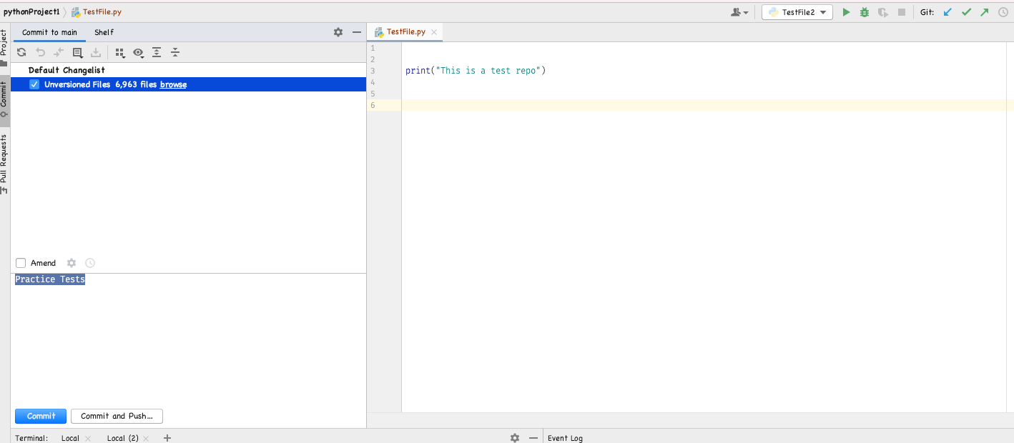
Click on Commit button.
Select the file name from the displayed left menu then click on Commit and Push button
Navigate back to Github and refresh the page. Both .py files should be displayed on the page.

Slide 41
REFERENCE NOTES
For further reference and understanding of Git and Github, please reference the below reading materials/videos. The commands used in this presentation are the utmost basic commands used in Github and there are more that can be learnt thru further research.
https://docs.github.com/en/github
https://www.youtube.com/watch?v=RGOj5yH7evk
https://www.youtube.com/watch?v=CRlGDDprdOQ&t=61s

Slide 42


